Slide 1
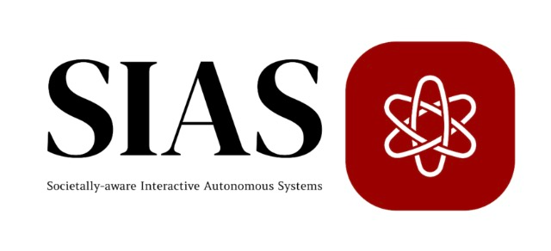
Strategic Optimization of Mixed Traffic Systems with AV Participation: From Urban Matching to Highway Behavior Control
Student: Kexin Wang
Advisor: Prof. Ruolin Li
Date: April 17th, 2025

Slide 2
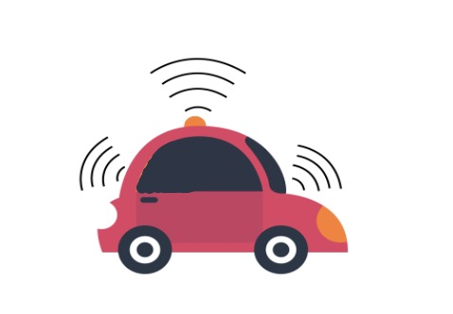



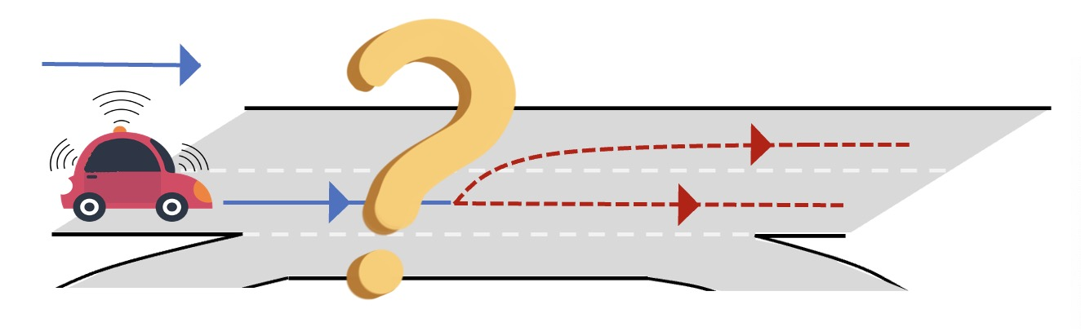
Mixed-Autonomy
Mobility Network
-> Routing scenario
Specific configurations that defines how traffic flows are generated, routed, and distributed across a network
Strategic Lane Choice Behavior
-> Highway weaving ramp scenario
Characteristics of AVs:
Behavioral predictability – follow rules
Strategic routing capability – regional controlled
communication – share information
Different effects for network/ stakeholders / traffic flow

Slide 3
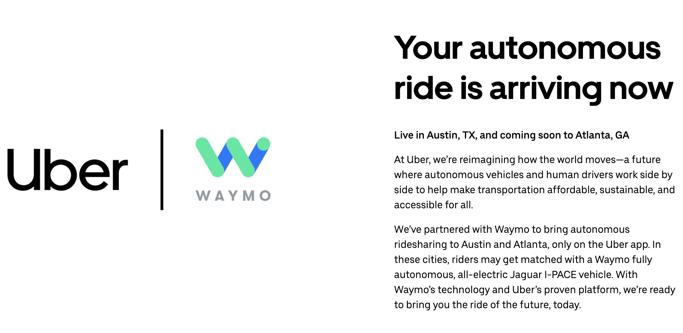

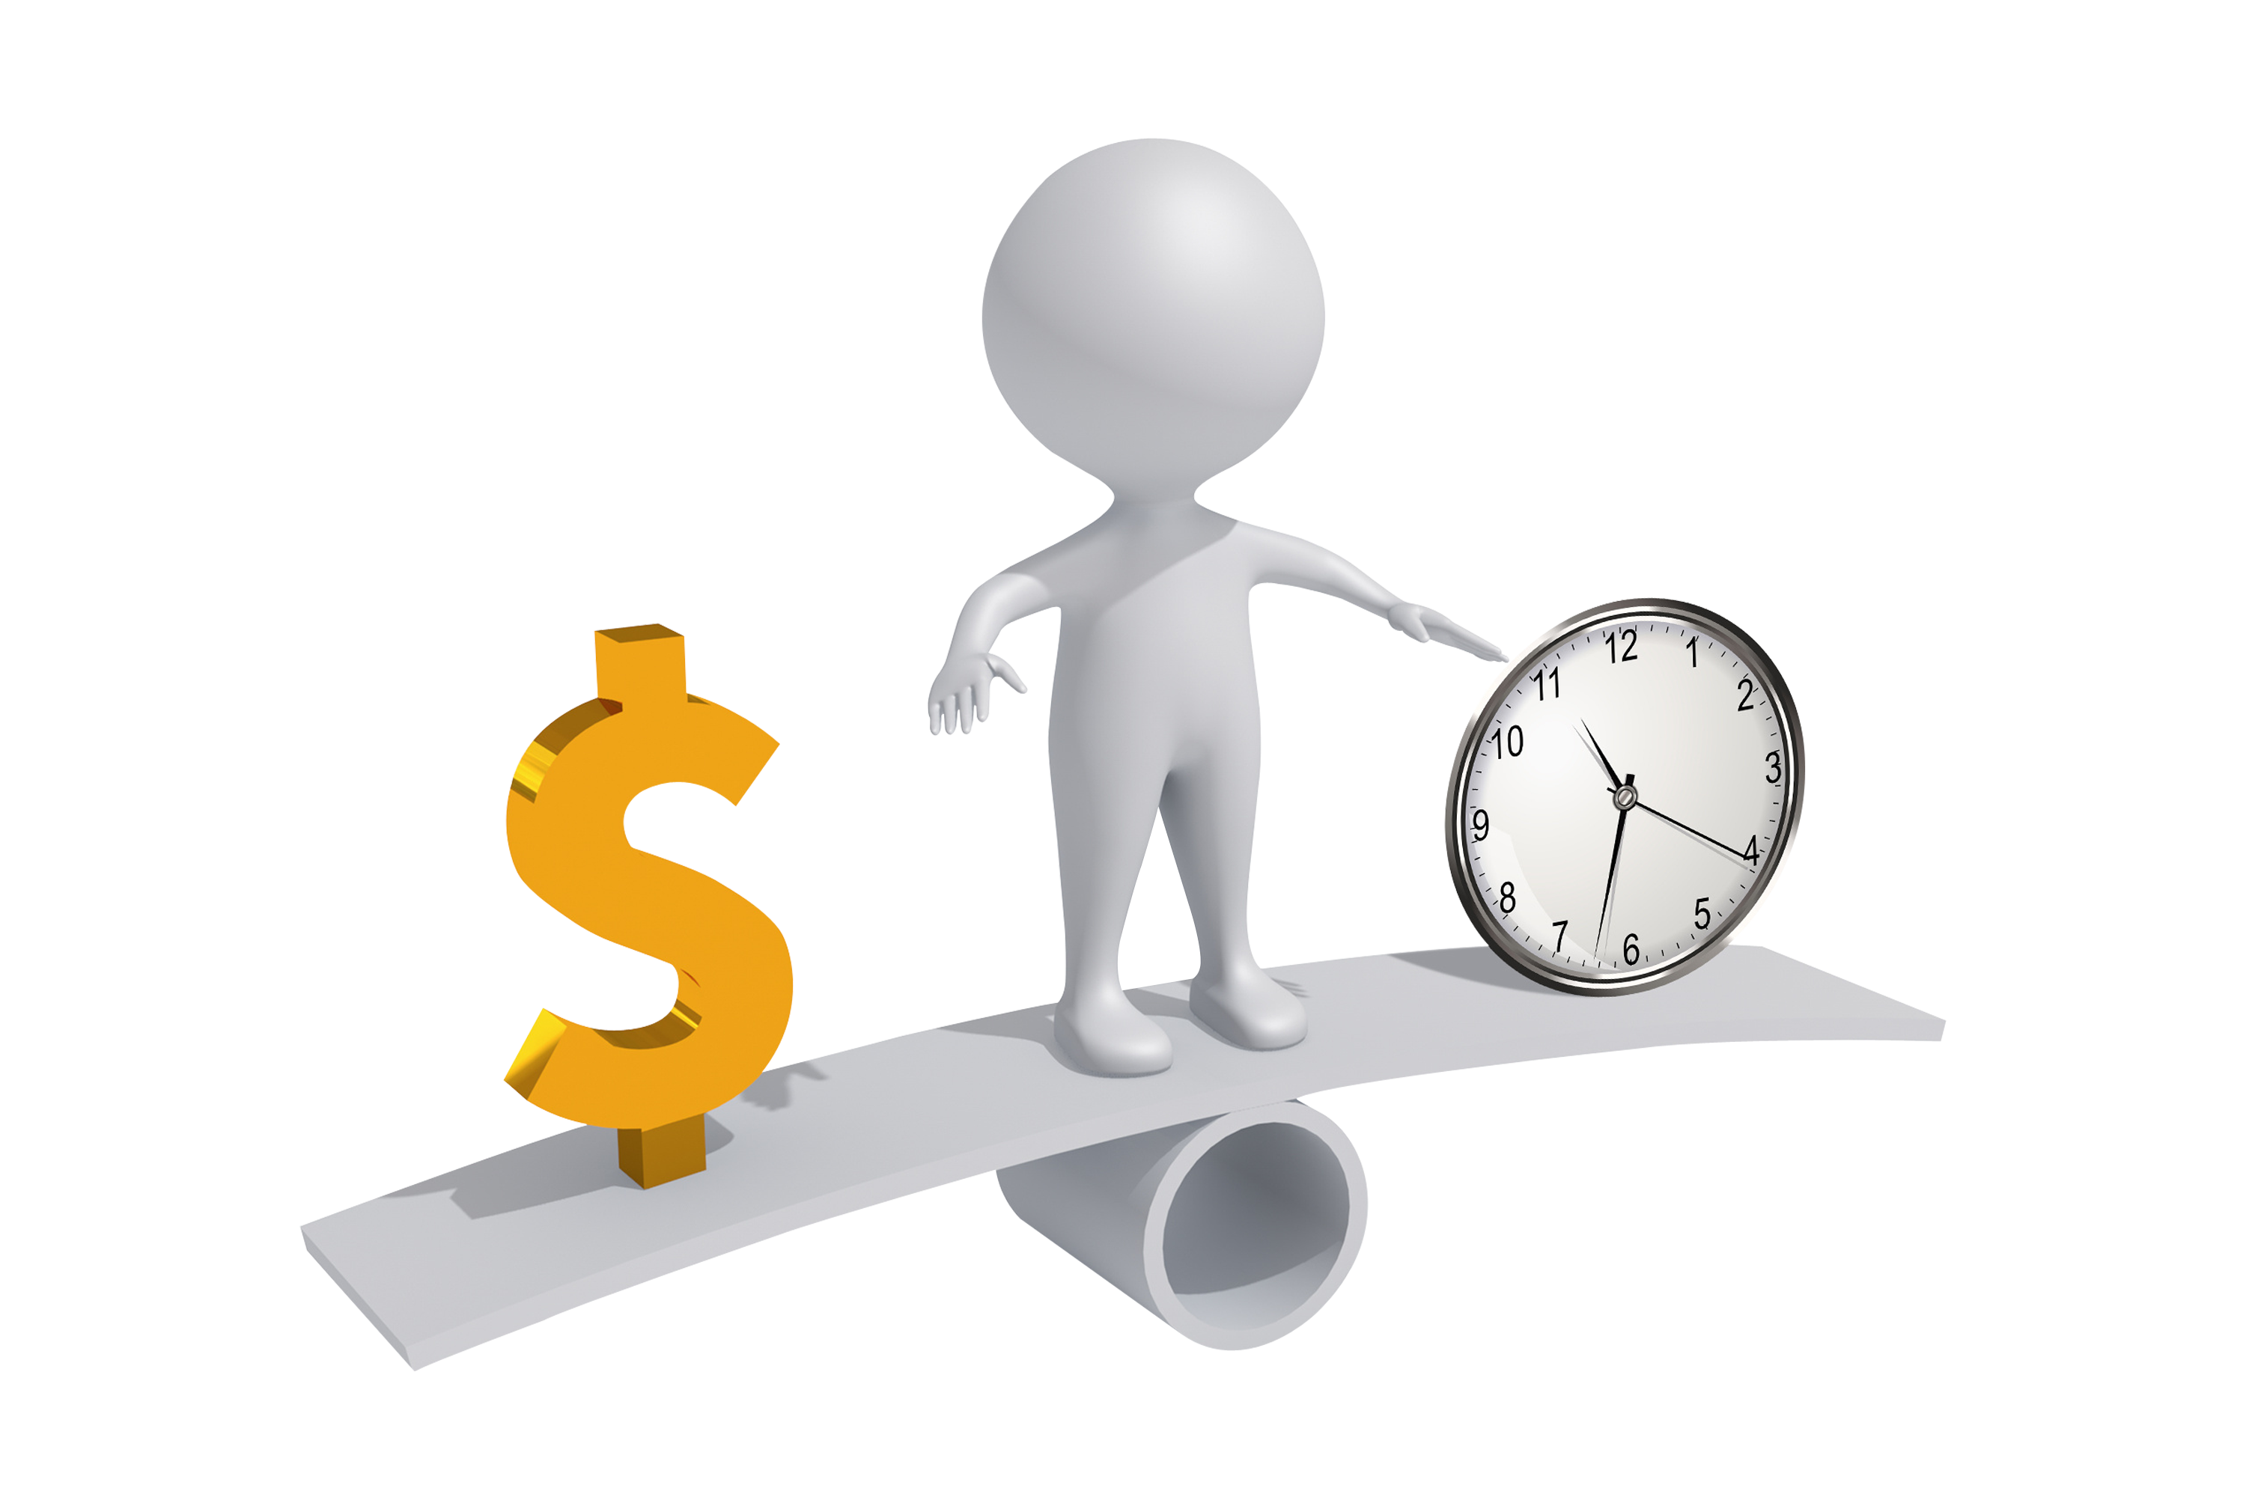
Strategic Interactions in Mixed-Autonomy Networks: Multi-Company AV/HV Fleet Operations and Policy Implications
News: Uber has partnered with Waymo to bring AVs to Austin and Atlanta.
Company
Customer
Each ride-sourcing company changes to manage both AV and HV fleets
For previous routing equilibrium framework, only care about HV fleets [1] [2]
Projective:
design a novel framework to characterize the mixed-autonomy routing equilibrium by integrating both supply-side and demand-side
profit-driven AV-operating companies delay-focused preferences of customers
[1] Ban, X. J., Dessouky, M., Pang, J. S., & Fan, R. (2019). A general equilibrium model for transportation systems with e-hailing services and flow congestion. Transportation Research Part B: Methodological, 129, 273–304.
[2] Di, X., & Ban, X. J. (2019). A unified equilibrium framework of new shared mobility systems. Transportation Research Part B: Methodological, 129, 50–78.

Slide 4
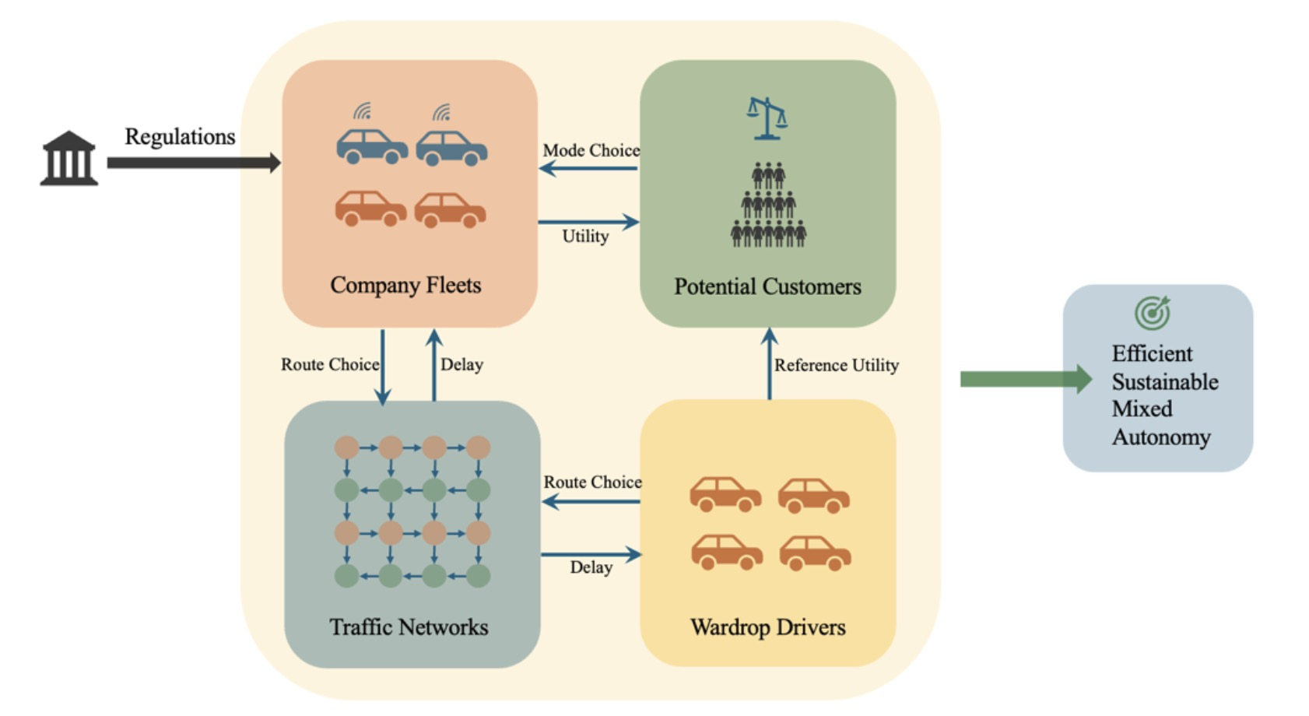
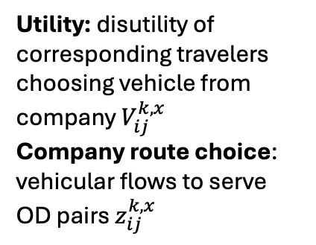
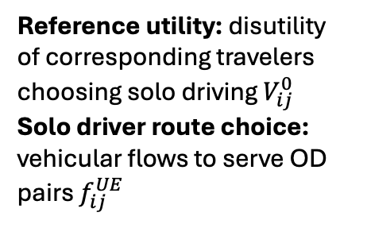
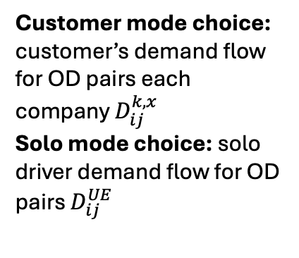
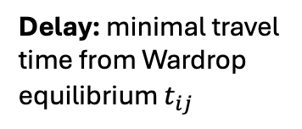
Conceptual Framework for Mixed-Autonomy Transportation Networks
Customer mode choice: customer’s demand flow for OD pairs each company $D_{ij}^{k,x}$
Solo mode choice: solo driver demand flow for OD pairs $D_{ij}^{UE}$
Regulations: government’s policy for each company’s number of HV/AV
Utility: disutility of corresponding travelers
choosing vehicle from company $V_{ij}^{k,x}$
Company route choice: vehicular flows to serve OD pairs $z_{ij}^{k,x}$
Reference utility: disutility of corresponding travelers
choosing solo driving $V_{ij}^{0}$
Solo driver route choice: vehicular flows to serve OD pairs $f_{ij}^{UE}$
Delay: minimal travel time from Wardrop equilibrium $t_{ij}$
ij – OD pair starts from origin i and ends to destination j
k - company type k x - vehicle type HV/AV

Slide 5
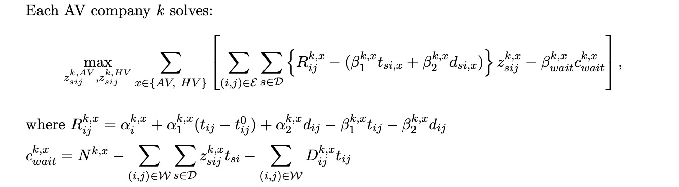
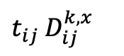
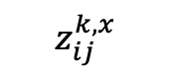
Mixed-fleet company choice model
$t_{ij}$ $D_{ij}^{k,x}$
$$z_{ij}^{k,x}$$
Objective: maximize profit for each company k
Fare and cost is separated into time-based and distance based
Waiting time cost is considered (wait for orders)
s
i
j
Routing
Distance
OD pair

Slide 6

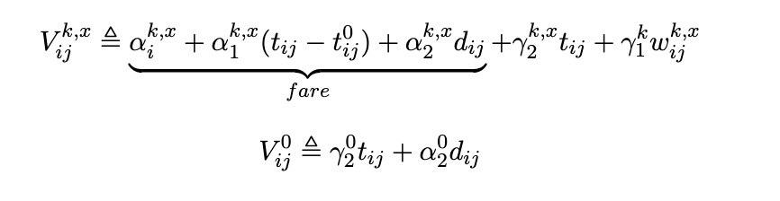
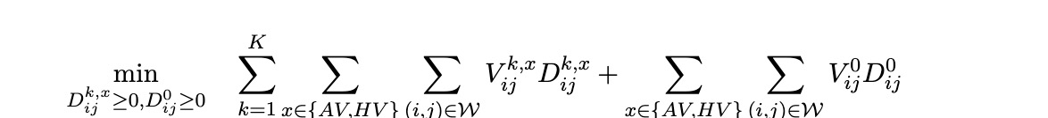
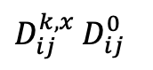
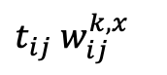
Traveler Choice Model
$t_{ij}$ $w_{ij}^{k,x}$
Solo driving?
Taxi/Autotaxi?
$D_{ij}^{k,x}$ $D_{ij}^{0}$
Objective: minimize disutility -> fare + time/distance-based disutility + wait to pick up time disutility
Time and money are 2 key reasons for people to choose service
Future work: divide different customer categories -> people own vehicles / do not own vehicles…

Slide 7
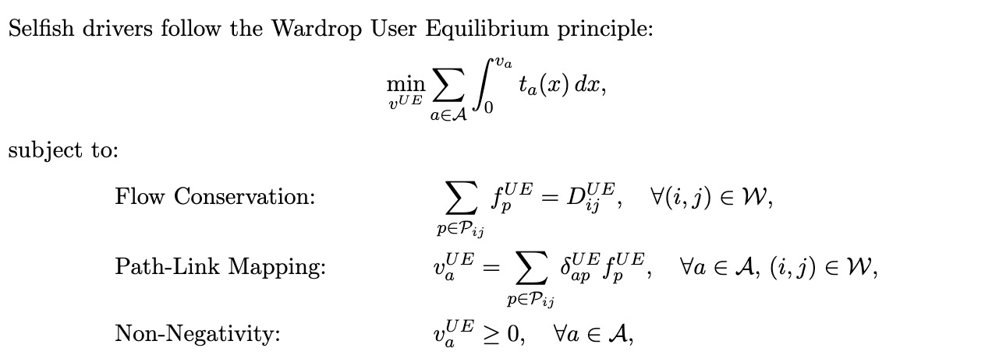
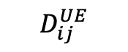
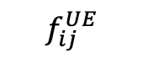
Solo driver model
$$D_{ij}^{UE}$$
$$f_{ij}^{UE}$$
Objective: minimize solo driver’s own cost (time delay)
This model decides which specific path solo drivers choose

Slide 8
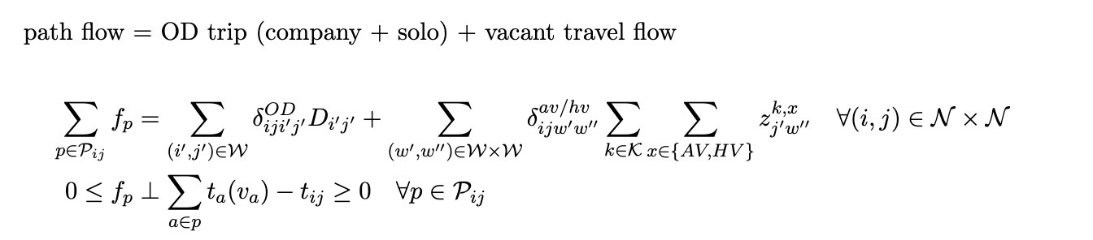

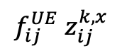
Traffic network congestion model
$$f_{ij}^{UE}{ z}_{ij}^{k,x}$$
$$t_{ij}$$

Slide 9
Future work
More constraints
Add regional constraints for AV -> Waymo cannot drive on highway currently
Add customer’s category -> some customers do not have vehicles, some only want to choose HV taxi…
Existence of solution proof
Numerical analysis
Is this model more realistic compared with other models?
How proportions of AVs affect the system?

Slide 10
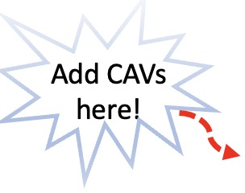
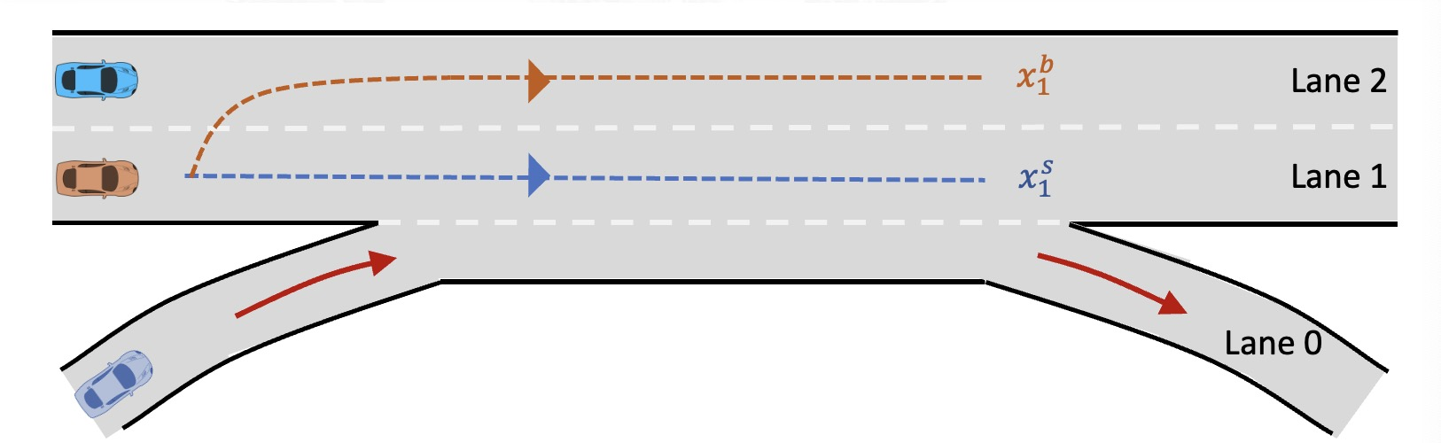
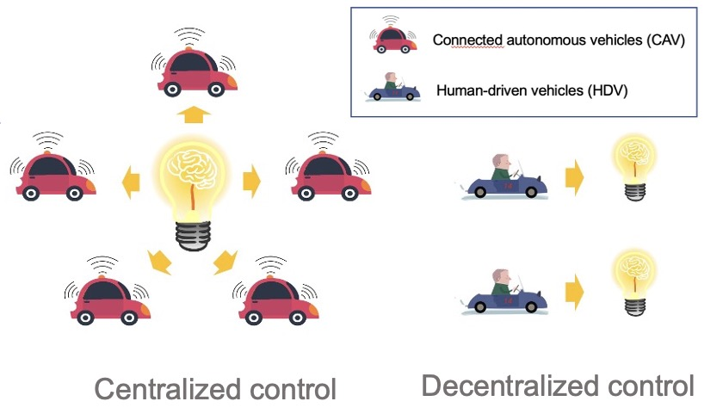
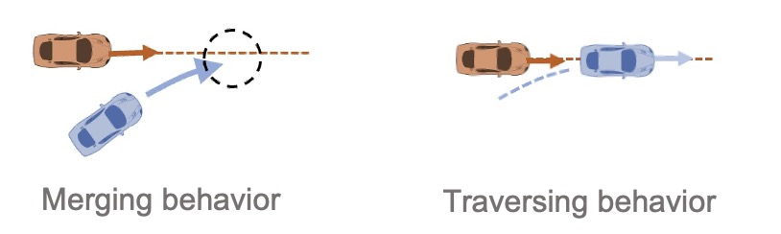
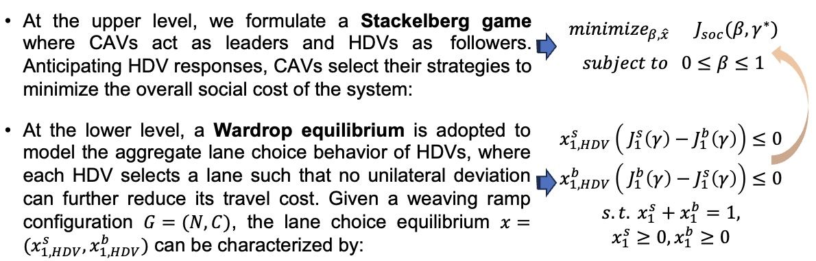
Optimizing Mixed Traffic Flow in Highway Weaving Ramps: A Stackelberg-Wardrop Game Approach

Slide 11
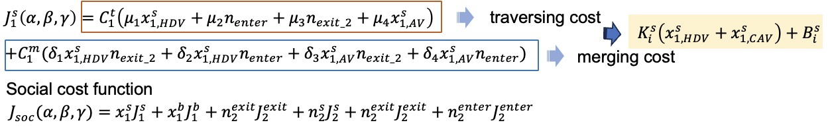
Optimizing Mixed Traffic Flow in Highway Weaving Ramps: A Stackelberg-Wardrop Game Approach

Slide 12
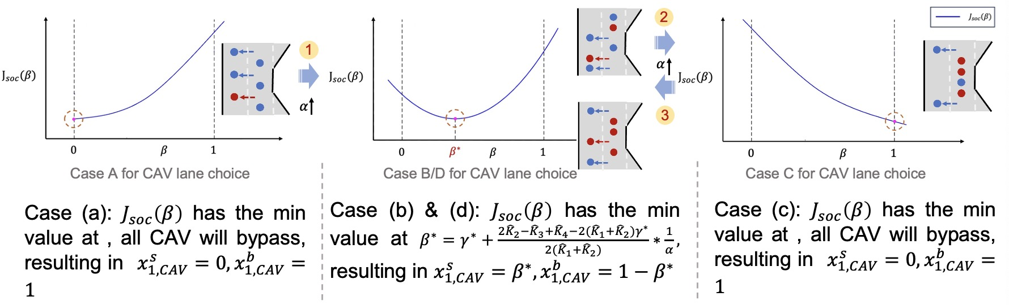
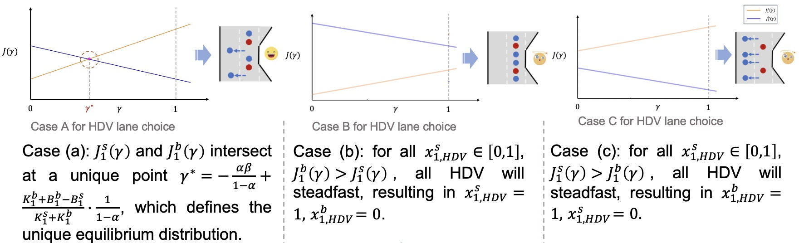
Stackelberg Optimization Analysis
Wardrop Equilibrium Analysis

Slide 13
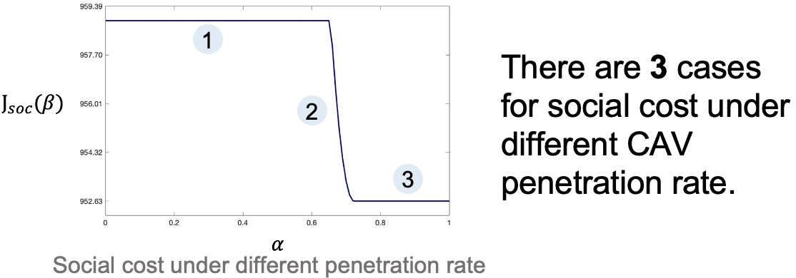
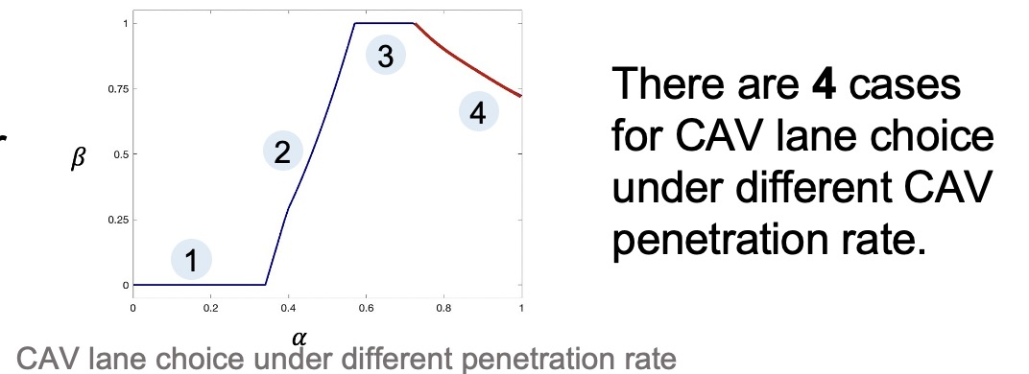
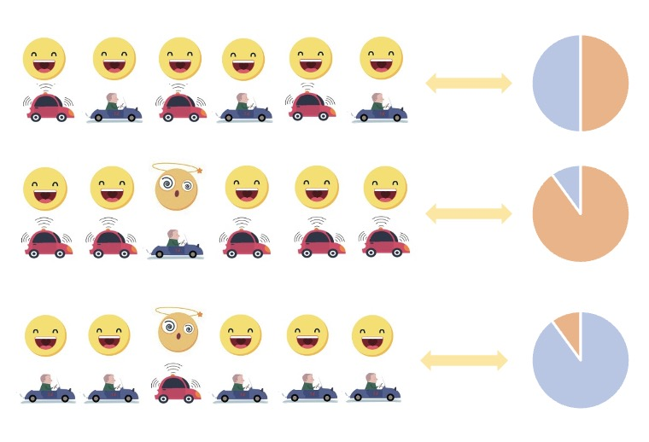
CAV penetration rate analysis
Lower penetration (0%-30%): CAVs behave similarly to HDVs, minimizing their own individual travel costs.
Transition phase (30%-60%): CAVs begin optimizing for overall traffic efficiency; however, HDVs capture cost of the benefits in terms of cost reduction.
Moderate to high penetration (60%-75%): CAVs are centrally controlled to actively optimize global traffic performance.
High penetration (above 75%): As CAV control dominates, their individual costs decrease significantly due to improved traffic conditions.

Slide 14
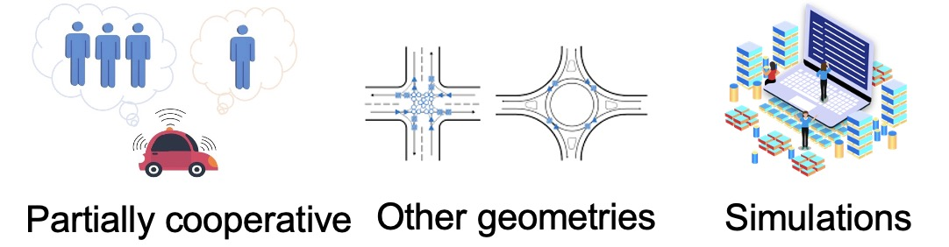
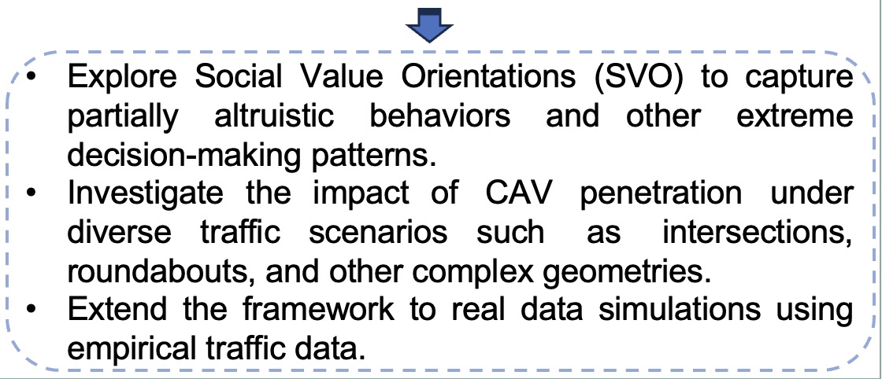
Future work

Slide 15
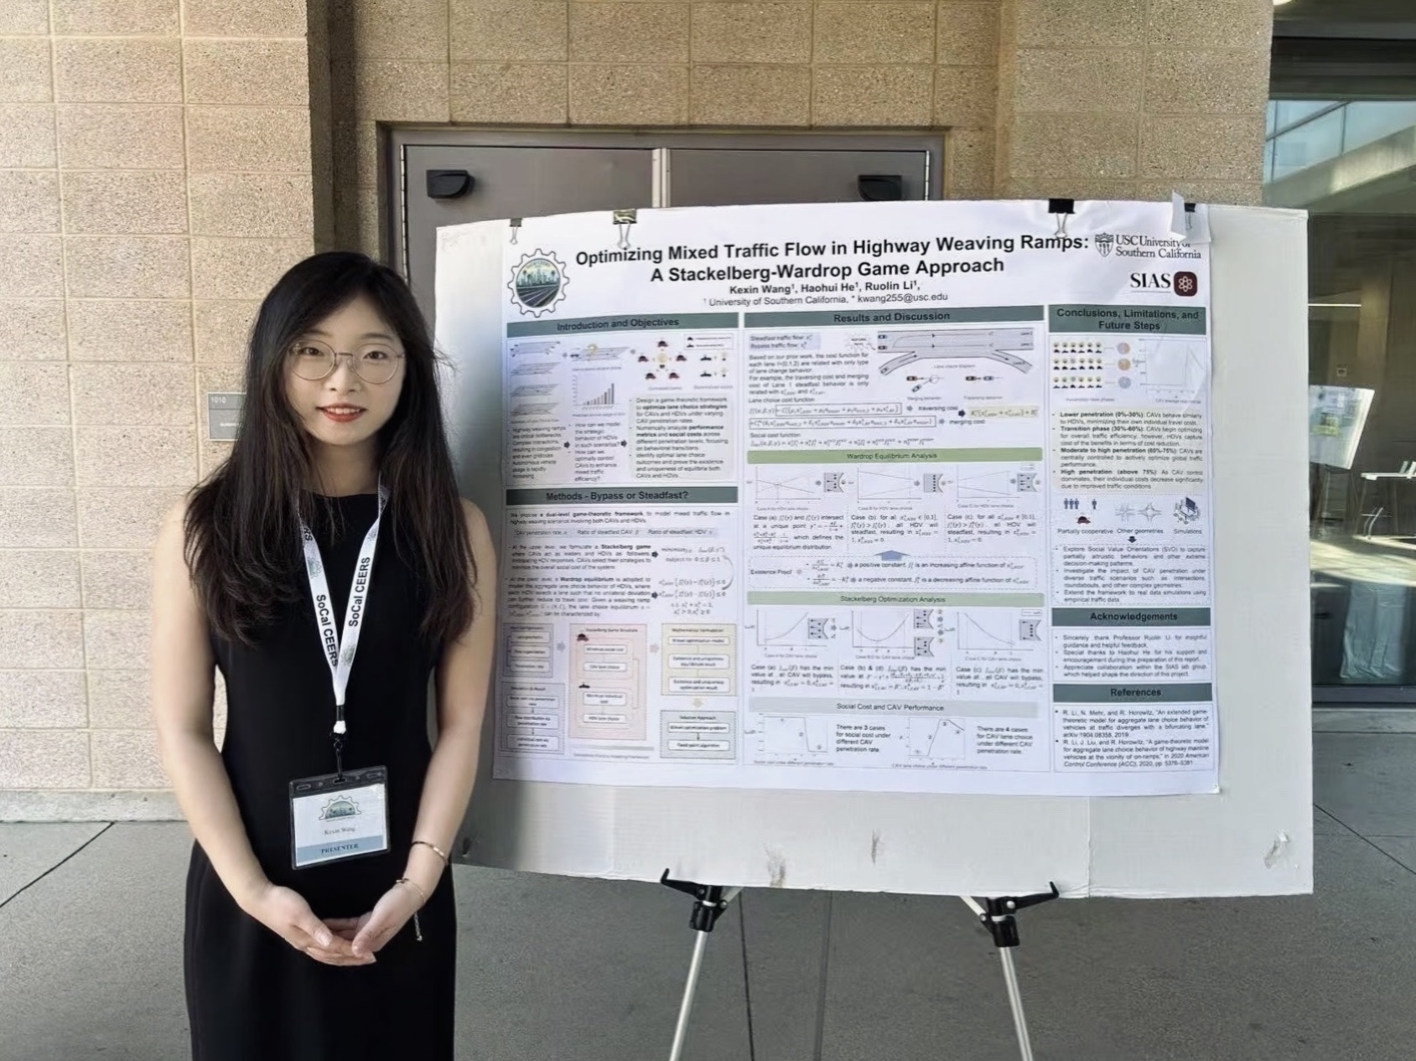
2025 SoCal CEE Research Symposium!

Slide 16
Thank You!

